Slide 1
UNDERSTANDING PHISHING ATTACKS: STRATEGIES FOR IDENTIFICATION AND PREVENTION

Slide 2

INTRODUCTION TO PHISHING ATTACKS
Phishing attacks are malicious attempts to obtain sensitive information by disguising as a trustworthy entity.
Understanding these attacks is crucial for efective prevention and identiﬁcation. This presentation will
explore various types of phishing, their impact, and strategies for safeguarding against them.

Slide 3
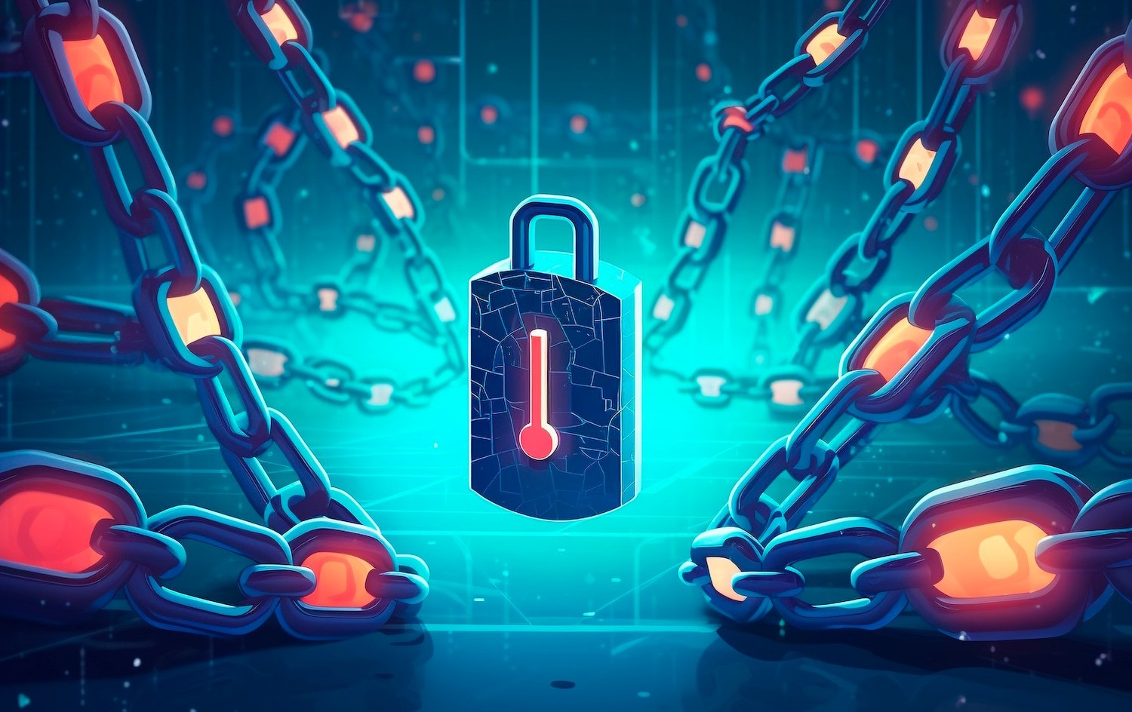
TYPES OF PHISHING ATTACKS
Phishing attacks can be categorized into several types: email phishing, spear phishing, whaling, and vishing. Each type targets individuals or organizations diferently, utilizing social engineering techniques to exploit human psychology and gain unauthorized access to sensitive data.

Slide 4

COMMON SIGNS OF PHISHING
Identifying phishing attempts involves recognizing suspicious signs. Look for generic greetings, unexpected attachments, or urgent language.
Phishing emails often contain poor grammar and misspellings, which can
serve as indicators of their fraudulent nature.

Slide 5

ROLE OF TECHNOLOGY
Technology plays a vital role in combating phishing. Utilize spam ﬁlters, anti-virus software, and email authentication protocols like SPF and DKIM. These tools can help identify and block phishing attempts before they reach the user, enhancing overall security.

Slide 6

PREVENTIVE MEASURES
To prevent phishing attacks, adopt several strategies: use multi-factor authentication, verify sender information, and avoid clicking on suspicious links. Regular training and awareness programs can signiﬁcantly enhance an organization's ability to recognize and respond to phishing threats.

Slide 7

LEGAL IMPLICATIONS
Phishing attacks not only harm individuals but also carry legal consequences for organizations. Failure to protect sensitive data can result in ﬁnancial penalties and reputational damage. Understanding the legal landscape is essential for compliance and risk management.

Slide 8

CASE STUDIES
Examining real-world case studies of phishing attacks can provide valuable insights. Analyzing how organizations responded and the lessons learned can help in developing more robust defense mechanisms against future threats.

Slide 9
CONCLUSION
In conclusion, understanding phishing attacks is essential for individuals and organizations alike. By recognizing the signs, implementing preventive measures, and leveraging technology, we can signiﬁcantly reduce the risk of falling victim to these malicious schemes.

Slide 10
Thanks!
Do you have any questions?
Contact info:- Raj kumar

